Slide 1
The wonderful world of Gabi Wulf

Slide 2
Breaking down the Optimal (2016) paper
Enhanced Expectancies
  Positive feedback
  Social-comparative feedback & Self-Modeling
  Perceived task difficulty
  Conceptions of ability
  Extrinsic rewards
  Positive affect
Autonomy
  Control over practice conditions
  Instructional language
  Incidental choices
External Focus of Attention
  Movement effectiveness
  Movement efficiency
  Movement form
Choose one of these topics as a group and read the section in the OPTIMAL (2016) paper found on Canvas, under Files -> week 7.
-Come prepared with 3 important things from your section for a discussion on Monday
→Your group will present this topic to the class on Monday
-We will be doing a lab activity on Wednesday based on our discussion on Monday

Slide 3
Class Layout
5 minutes to work in your groups to solidify what you’ll teach your peers from your section of the reading and how you’ll present it
  Group assignments found on Canvas (Files -> week 7 excel file)
  2 minutes/presentation
Spend the rest of our time working through how to assess motor learning by playing with some of the ideas presented today.
  This will be the guide to how we do lab on Wednesday (or Wednesday & Friday for the MWF section)

Slide 4
Something to Think About…
”Is confidence simply a “side effect” of expertise, or can confidence-enhancing measures facilitate learning in beginners?” (Wulf, p. 1384)

Slide 5
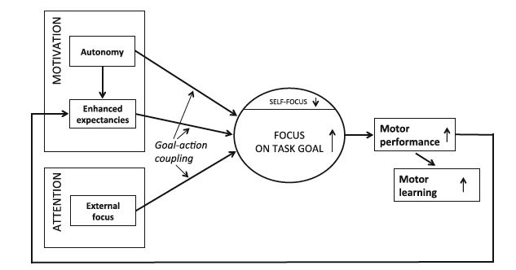
OPTIMAL Theory of Motor Learning
Notes:
By manipulating factors related to motivation and attention, you can truly improve motor learning.
Enhanced Expectancies:
Expectations shape reality
Circumstances that enhance learners’ expectations of future performance success can potentiate even more success, improvement, and learning
Autonomy:
Allowing individuals to exercise control over the environment
Giving the learner control over certain aspects of the practice conditions enhances motor skill learning
External Focus:
Attention focused on an external element of the task rather than internally on how the body moves

Slide 6
The OPTIMAL theory builds on the premise that motor learning cannot be understood without considering the motivational (e.g., social-cognitive and affective) and attentional influences on behavior.
-Wulf & Leithwaite (2016)

Slide 7
Motivation
1. Autonomy
2. Enhanced Expectancies
Motivation: broad, inclusive term for factors influencing and encompassing the energization, direction, and intensity of behavior.
We act when future prospects provide a sense that positive outcomes will occur
  Perhaps particularly when we believe we will be the agents who bring these positive outcomes to fruition
-Remember, movement and motivation come from the same root word.

Slide 8
Autonomy
The need to actively participate and exercise control over the environment may satisfy basic human needs
Human motivation is dependent on the perception of one’s actions having effects on the environment
  Even if the effects of one’s actions are trivial
Giving learners choices can positively influences motor learning
  Deeper processing of relevant information
  Encourages error estimation
  Fosters the use of self-regulation strategies
  Or, simply, more motivating

Slide 9
Control Over Practice Conditions

Slide 10
Instructional Language

Slide 11
Incidental Choices

Slide 12
Motivation
1. Autonomy
2. Enhanced Expectancies
Attention
External Focus

Slide 13
Enhanced Expectancies
AKA: Confidence before you try something new
Variables that enhance expectancies for future performance success have a beneficial effect on motor skill learning
  Including those that satisfy the psychological need for competence (experiencing oneself as capable and competent)
Expectations anticipate rewarding properties
  Increase in dopamine
Enhanced self-efficacy, increased task interest or satisfaction with one’s performance, reduced concerns about one’s performance or abilities, and greater positive affect support the notion that learning is mediated by motivational factors.
Notes:
”Human beings appear to have a propensity to prefer positive information about themselves, such as positive feedback abou thtier performance or physical fitness, athleticism, health, and physical attractiveness”

Slide 14
Positive Feedback

Slide 15
Social-Comparative Feedback

Slide 16
Self-Modeling

Slide 17
Perceived Task Difficulty

Slide 18
Conceptions of Ability

Slide 19
Extrinsic Rewards

Slide 20
Positive Affect

Slide 21
External Focus of
Attention

Slide 22
“What does the mountain goat about to jump across a chasm focus on?
Presumably, it focuses on the other side of the chasm to which it is jumping. Its motor system seems to “know” what it has to do to achieve the desired outcome.
A skilled and confident human in a similar situation might also let his or her motor system do its job and successfully land on the intended spot.”
  -Wulf & Leithwaite (2016)
Notes:
Those of us who are in the exercise prescription domain need to be particularly careful to make sure we don’t get too honed in on an internal focus in training others or in our own workouts.

Slide 23
External Focus of Attention
Addresses the question: “what should learners focus their attention on?”
  Remember the phases of motor learning: 1)cognitive; 2)associative; 3)autonomous
Instructions direction attention away from one’s body parts or self and TO the intended movement effect
  Focus on the intended movement outcome rather than an internal focus on body movements
Concentration on the intended movement effect enhances motor performance and learning
  Directs attention to the task goal
  Reduces a focus on the self

Slide 24
Movement Effectiveness

Slide 25
Movement Efficiency

Slide 26
Movement Form

Slide 27
Ending discussion on lab activities for Wednesday

Slide 28
What do you want to work through in more detail in lab on Wednesday?
Autonomy
  Control over practice conditions
  Instructional language
  Incidental choices
External Focus of Attention
  Movement effectiveness
  Movement efficiency
  Movement form
Enhanced Expectancies
  Positive feedback
  Social-comparative feedback & Self-Modeling
  Perceived task difficulty
  Conceptions of ability
  Extrinsic rewards
  Positive affect

