Slide 1
Intro to Motor Learning Part 2
How to measure motor learning
-Practice/acquisition
-Retention
-Transfer

Slide 2
Motor Learning
Motor Learning: the relatively permanent change in performance
  Resulting from practice & experience
*Not directly observable:
  Must infer the neuromotor changes from changes in performance
    Improved perceptual reading of the task (stimulus identification)
    Improved decision making (response selection)
    Improved motor performance (response programming)
    Changes in neuroplasticity
**Describe movement outcomes: the extent to which a given movement achieved the intended goal.

Slide 3
https://www.youtube.com/watch?v=LXiEwDnFzrk
Through Russ
Not his muscles
But percussion he provides
”Clint Eastwood” by the Gorillaz

Slide 4
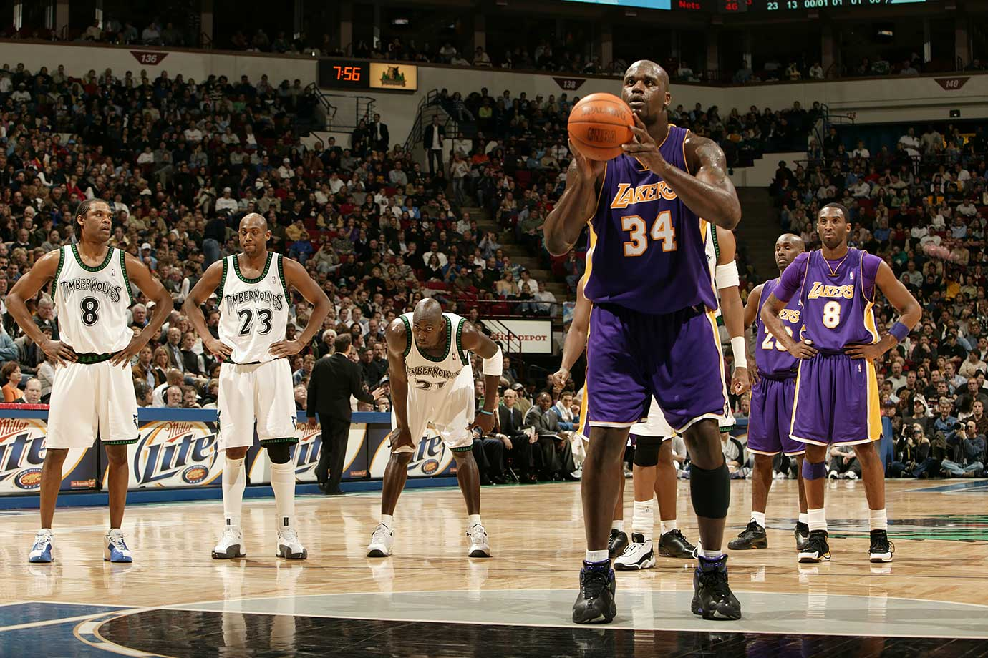
Indirect Ways to assess learning
Distance
Speed
Accuracy
Form

Slide 5
How could you assess learning In…
Swimming
Soccer – offensive vs. defensive players
Archery
Batting in baseball or softball
Weight Lifting
Golf
Chess
A video game
Playing Piano
Slacklining
Disc golf (frisbee)
Juggling
Skateboarding
Standing or Walking
Fencing
Riding a bike
Dance routine
Tennis
Etc…

Slide 6
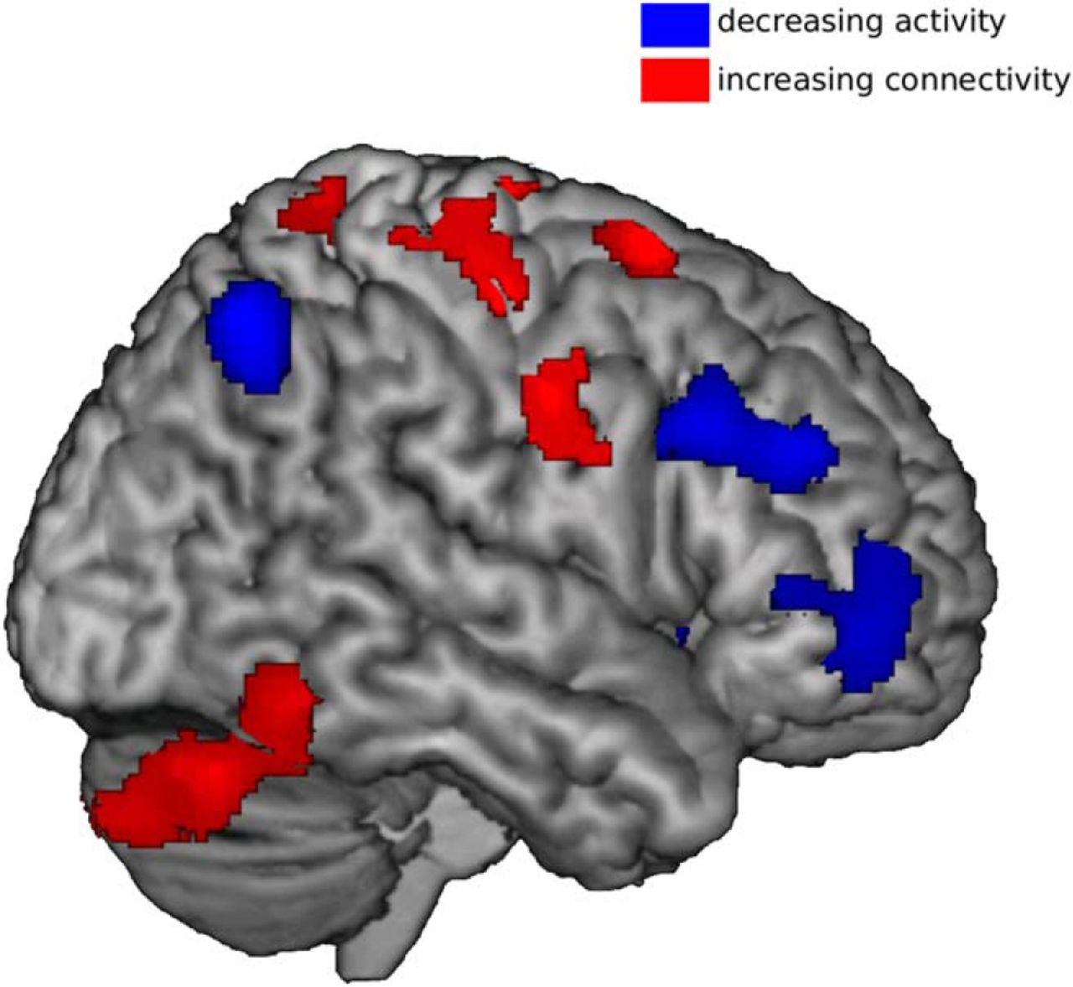
Other, higher tech ways to measure motor learning
Electromyography (EMG)
  Muscle activity
  https://www.youtube.com/watch?v=Glki2UPFl2s
fMRI (functional Magnetic Resonance Imaging)
  Blood oxygenation to region of the brain involved in an activity
TMS (transcranial magnetic stimulation)
  Stimulation intensity necessary to elicit muscle contraction
Eye Tracking
  What are you visually paying attention to?
  https://www.youtube.com/watch?v=jXgVVIBd0lc
Notes:
https://www.iat.uni-leipzig.de/datenbanken/iks/bms/Record/4032627
Expert vs. novice swim coaches
http://rit-mcsl.org/fairchild/PDFs/PutterTracking.pdf
Expert vs. novice putting

Slide 7
How to do a motor learning study
https://www.youtube.com/watch?v=m_5nWKyRzKM
(Watch until ~2 minutes)

Slide 8
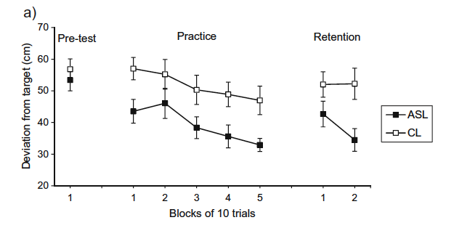
(Blocks of trials is the scientific way of saying sets of reps)
Notes:
Blocks of trials is the scientific way of saying sets of reps

Slide 9
Key Terms in Motor Learning studies
Practice/Acquisition: short term learning within a relatively small period of time
Retention: relatively permanent change in ability; test performance on same task after some rest
  Retention Interval: the period of time between acquiring the skill and performing the retention trials.
    Susceptible to forgetting, if the retention interval is too long.
Transfer: test performance on a related task
  For example: practice tennis serving, transfer test is badminton serving.

Slide 10
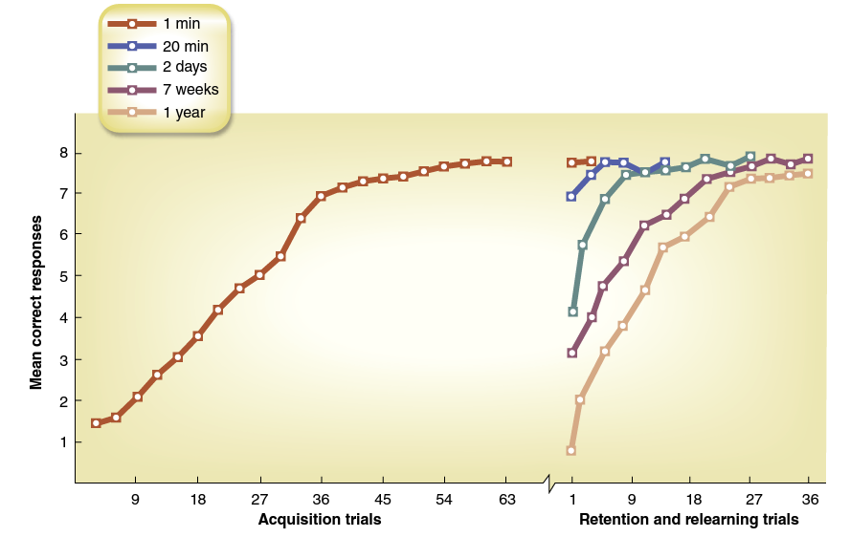

Slide 11
Preparing for next week!
The wonderful world of gabi wulf

Slide 12
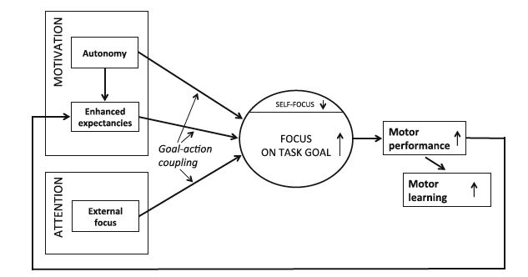
OPTIMAL Theory of Motor Learning
Notes:
By manipulating factors related to motivation and attention, you can truly improve motor learning.
Enhanced Expectancies:
Expectations shape reality
Circumstances that enhance learners’ expectations of future performance success can potentiate even more success, improvement, and learning
Autonomy:
Allowing individuals to exercise control over the environment
Giving the learner control over certain aspects of the practice conditions enhances motor skill learning
External Focus:
Attention focused on an external element of the task rather than internally on how the body moves

Slide 13
Breaking down the Optimal (2016) paper
Enhanced Expectancies
  Positive feedback
  Social-comparative feedback & Self-Modeling
  Perceived task difficulty
  Conceptions of ability
  Extrinsic rewards
  Positive affect
Autonomy
  Control over practice conditions
  Instructional language
  Incidental choices
External Focus of Attention
  Movement effectiveness
  Movement efficiency
  Movement form
Choose one of these topics as a group and read the section in the OPTIMAL (2016) paper found on Canvas, under Files -> week 7.
-Come prepared with 3 important things from your section for a discussion on Monday
→Your group will present this topic to the class on Monday
-We will be doing a lab activity on Wednesday based on our discussion on Monday

