Slide 1
Intro to Motor learning
Week 6
Whitney Ogle

Slide 2
Outline
Define and differentiate the stages of motor learning
  Make connections between motor learning and learning in school
Explore methods to measure motor learning
Discuss the differences among practice, retention, and transfer

Slide 3
Stages of motor learning
-Fitts & Posner model
-Bernstein Model
-Bloom’s Taxonomy

Slide 4
Fitts & Posner
3. Autonomous
2. Associative
1. Cognitive

Slide 5
1. Cognitive Phase
What do I have to do?
Learner has an idea of the task but is unsure how to do it
  Learner understands “what to do”
AKA “verbal motor stage”
  Learners may need to verbalize the movements
Performance is inconsistent
  Learner is trying many different strategies
  Develop a basic movement pattern through trial and error
High Attentional demand
  Learner has to pay attention to the relevant information related to the skill

Slide 6
2. Associative Phase
How do I do it?
Learners begin developing awareness of mistakes
  Develops an internal reference of correctness (sensory feedback of the correct movement)
  Begins to learn what “feels right”
Performance is becoming more refined
  Effort becomes more consistent (↓ errors)
Improving selective attentional focus
  Can start focusing on other aspects of the environment
Coaching feedback
  Should be precise & should start to decrease so that the learner gains their own error-detection mechanism

Slide 7
3. Autonomous phase
Do it
Performance is more automatic
  Flow state
Minimal cognitive processing about how to do the task
  Less susceptible to distractions in the environment
  More thinking about planning and strategy
Aware of mistakes and how to correct them
Coaching Instruction should be given on a particular aspect of the skill

Slide 8
Bernstein Model
Degrees of Freedom: every joint that can move in the body is one degree of freedom
Early:
  Movement is rigid
    Controlling/Freezing the degrees of freedom
Middle:
  Movement is becoming more coordinated
    Begin releasing the degrees of freedom
Late:
  Movement is fluid; optimal movement patterns
    Exploit the degrees of freedom
Early
Middle
Late

Slide 9
Slacklining
      https://www.youtube.com/watch?v=3bl45C1f5hE

Slide 10
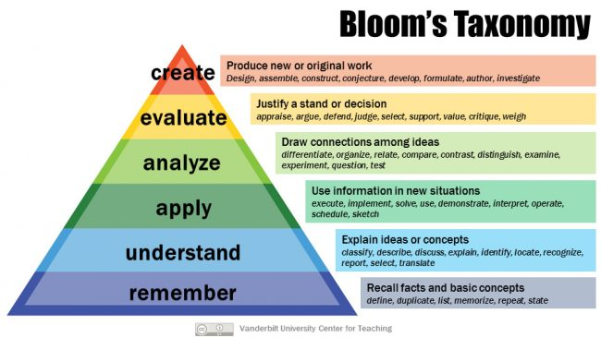
Bloom’s Taxonomy

Slide 11
What are the similarities between the Fitts & Posner model and Bernstein?
What are the similarities between stages of motor learning and Learning from Bloom’s Taxonomy?
Give examples of stages of learning in school and sport.

