Slide 1
Cognition & Action
Week 4
Fall 2017
KINS 484

Slide 2
Learning Outcomes
Students will be able to:
  Differentiate between open and closed loop control of movement
  Understand the value of attention and motivation in motor learning and development
  Identify and describe key structures of the central and peripheral nervous system as they relate to movement production (Wednesday – Friday)

Slide 3
Open vs. Closed Loop Control of Movement

Slide 4
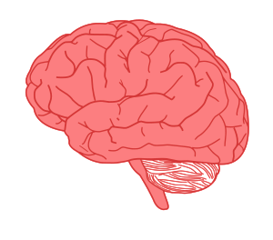
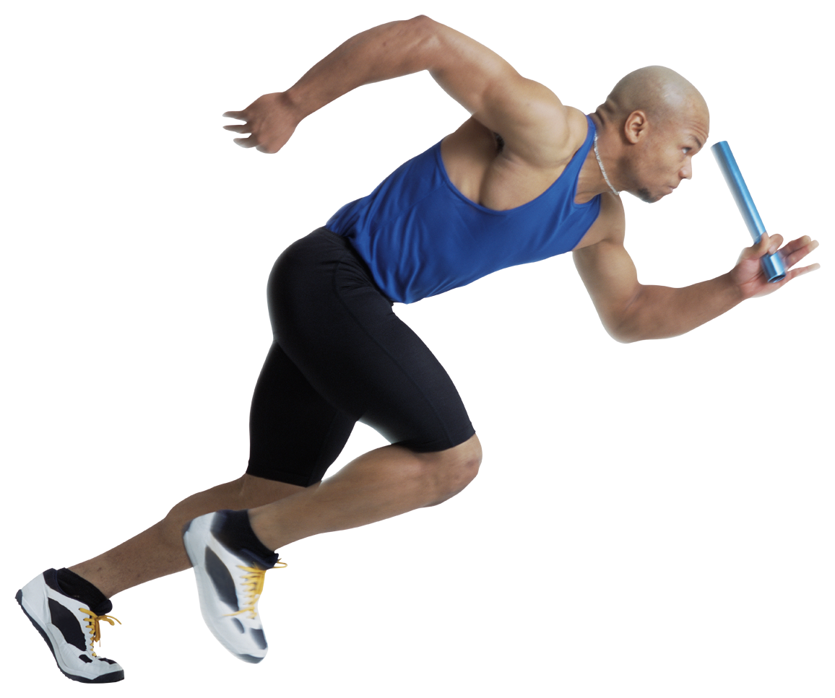
Open Loop Control = feedforward = top down
Sense
Think
Do
Stimulus Identification
Response Selection
Response Programming
Notes:
Open loop only makes sense with discrete fast movements, where you don’t have to control for error.
No sensory feedback.

Slide 5
Closed Loop = using sensory feedback
Stimulus Identification
Response Selection
Response Programming
Muscles
Reference of Expected Results
Movement
Environment
Feedback from movement sensation (interoception) and from the environment (exteroception).
-Was there a difference between what I expected and what actually happened?

Slide 6
Reference of Expected Results
Stimulus Identification
Response Selection
Response Programming
Muscles
Reference of Expected Results
Movement
Environment
If the feedback matches what was expected, the movement was done correctly and no adjustments are necessary
If there is a difference between the feedback received and the reference, then an error is signaled and a correction is required
Notes:
Expectations: generate movement in a form that is appropriate for its surroundings
This ability to compare expectations with reality during movement is how we’re able to correct for errors during movement.

Slide 7
Open Loop vs. Closed Loop
Open Loop –
  Softball pitch
  Hitting the ball as a batter
  Letting go of the bow in archery
  Casting a fishing line
Closed Loop –
  Driving a car
  Skateboarding, Surfing
  Aiming in archery
  Reeling in a fish

Slide 8
Get into groups of 4
Assign people into:
1. sensory – 2. thinking – 3. doing – 4. expectations of movement

Slide 9
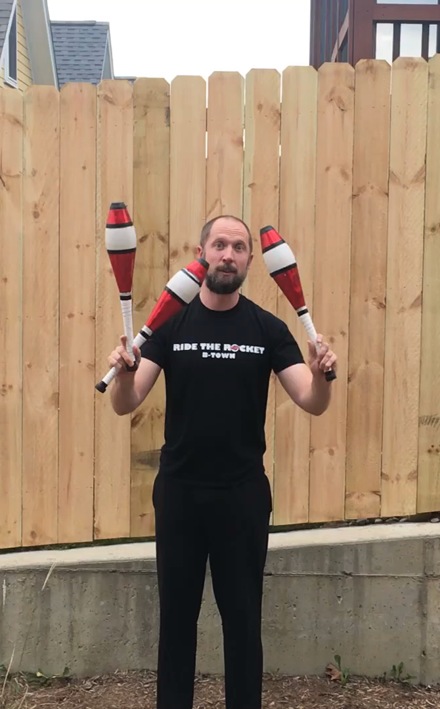
Expectations = Reality
What did he expect to happen?
What are the primary senses he is using?
What does he have to think about?
What did he do?
Cognitive Processing
Motor Action
Sensory Perception

Slide 10

Expectations ≠ Reality
Cognitive Processing
Motor Action
Sensory Perception
What did he expect to happen?
What are the primary senses he is using?
What does he have to think about?
What did he do?

Slide 11
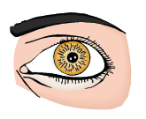
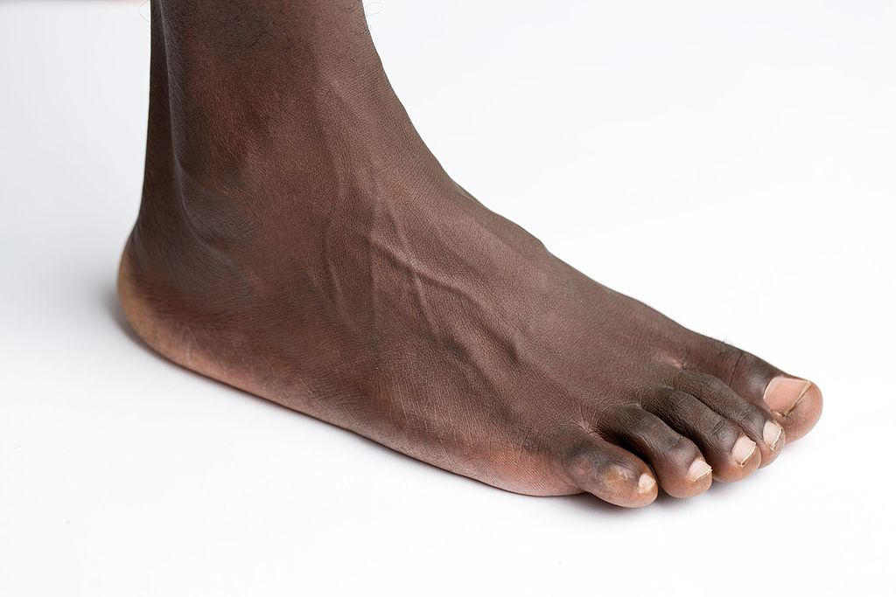
How we move
Cognitive Processing
Motor Action
Sensory Perception
Feed-Back
Feed-Forward
Notes:
Another way to look at the information processing model is as a continuous cycle. Or as a conversation between the brain and the body.
Feedforward or a top-down approach
Feedback or a bottom-up approach
Our ability to produce coordinated movement in a variable environment reflects the essential relationship between the feedforward motor plan and sensory feedback.

Slide 12
Open & Closed Loop Control Summary
Open Loop (aka Feedforward) control of movement:
  The brain tells the body what to do
  The body does what it has been instructed to do without the possibility of correction in case something goes wrong
Closed Loop (aka Feedback) control of movement:
  The brain tells the body what to do and constructs a ”reference” for what it expects to feel once the body does what it is told.
  The body does what it has been instructed to do and sensory feedback from the movement is compared to the “reference” of expected results
  If the sensory feedback matches what the brain expected, we don’t need to change
  If the sensory feedback DOES NOT match what the brain expected, we become consciously aware of the error and make a correction.

Slide 13
We are continually constructing little anticipatory patterns in our brain to help us predict the future: if I smile, then she’ll smile.
If our model meshes with what actually happens, we experience a little drip of sweet affirmation.
If it doesn’t, then there’s a problem, and the brain has to learn what the glitch is and adjust the model.
David Brooks from “The Social Animal”

Slide 14
Attention and Motivation
Why would you pay attention to one thing over another?

Slide 15
Attention:
Bottom Up Attention (Closed Loop)
  Look at the door because someone just opened it unexpectedly
  Look at your phone because you saw it light up, letting you know you just got a text
Top Down Attention (Open Loop):
  Look at the door
  Look at your phone

Slide 16
Attention & Motivation
Describe a time when you were motivated to pay attention

Slide 17
Attention to Errors
When expectations don’t match reality, we become consciously aware/our attention becomes devoted to that sensory perception.
  Like when you’re entering your password and it says you didn’t submit the correct password, you’re more likely to slow down and try it again.
When expectations don’t match reality, we can learn from the disconnect to make the difference between expectations and reality smaller.

Slide 18
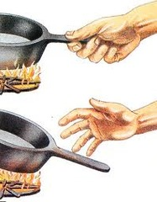

Attention to Pain
Attention to painful stimuli is prioritized over other senses to help protect the body from injury
Depending on the intensity and perceived nature of the threat, painful information could induce
  Quick reflexive movement
  ⬇ movement

Slide 19
Motivation
What motivates us to move?
Is it similar or different across the lifespan?
  Infants
  Children
  Teenagers
  Adults
  Older Adults
  Elderly

