Slide 1
Sensory Perception

Slide 2
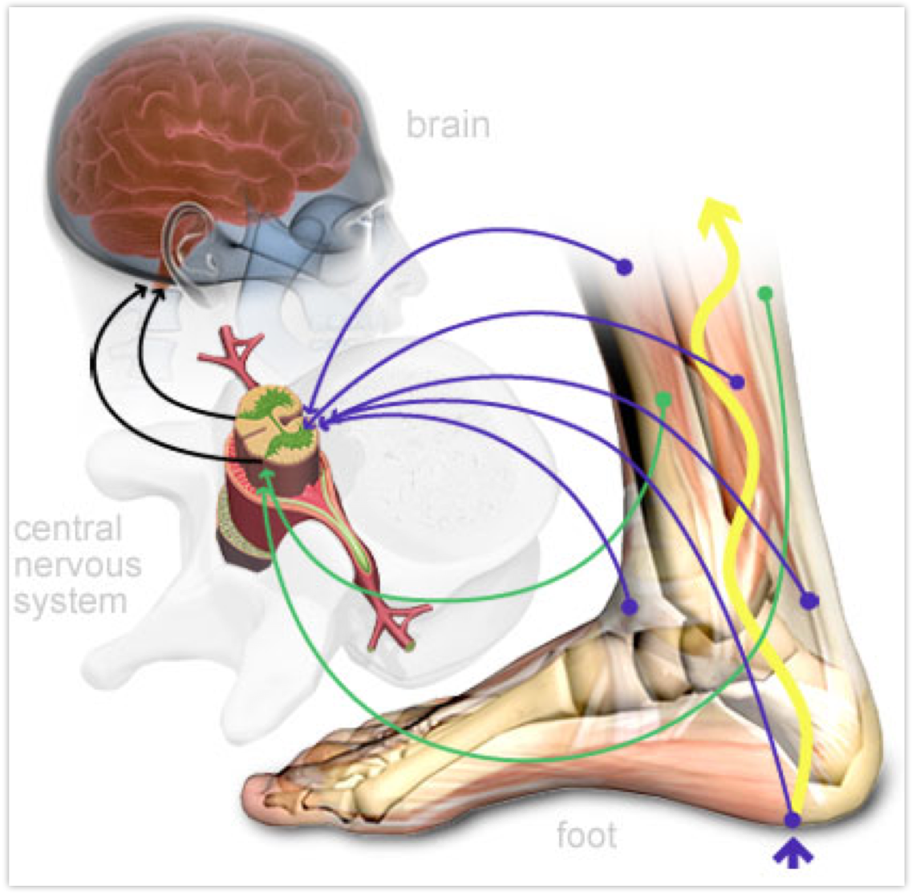
Overview of the next few weeks
How the brain & body communicate
Week 2: Sensory Perception
Week 3: Information Processing
Week 4: Cognition & Motor Action
Week 5: Review and Exam 1

Slide 3
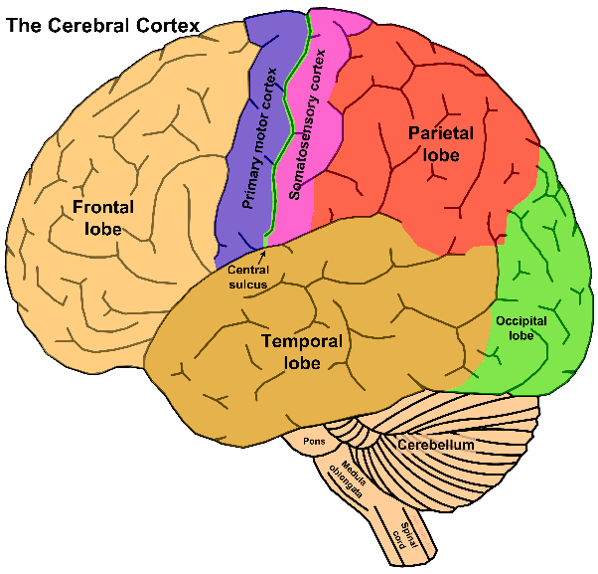

Slide 4
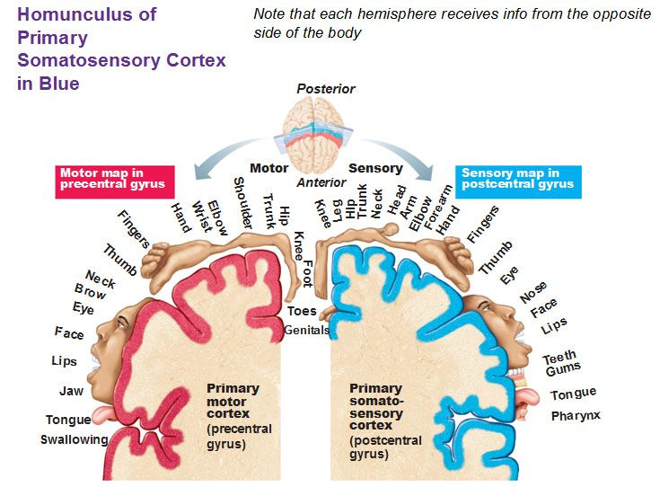

Slide 5
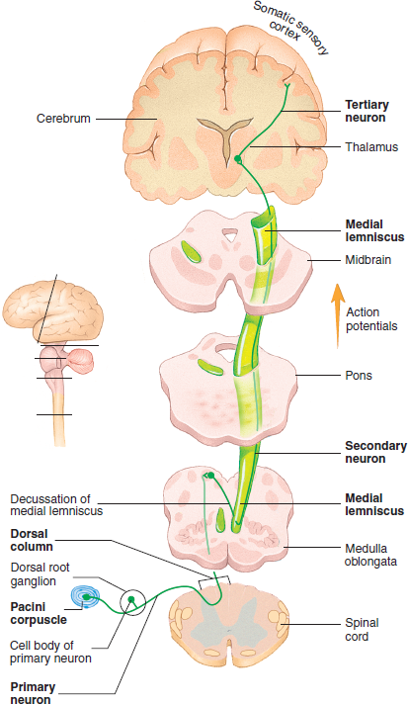
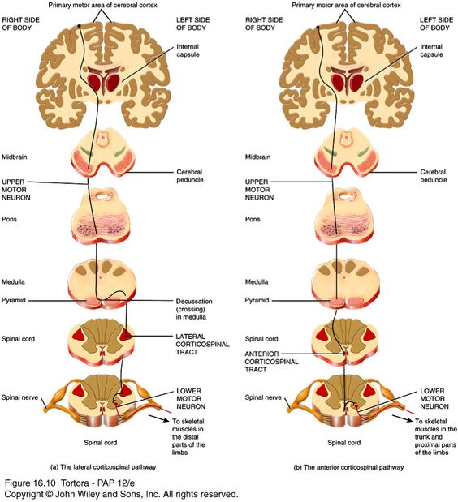
Ascending vs. Descending Pathways
Ascending = from body to the brain = Afferent = Sensory
Descending = from the brain to the body = Efferent = Motor
Week 2
Week 3, 4

Slide 6
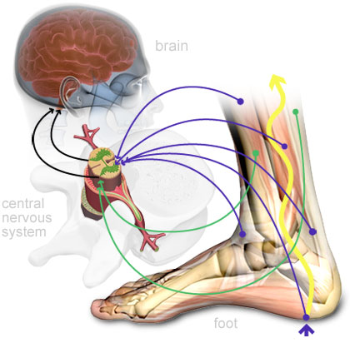
Sensory Feedback (Afferent))
Feedforward Motor Command (Efferent)

Slide 7
Week 2: Sensory Perception

Slide 8
Objectives
Describe important sensory information that helps to guide movement
Introduce key features of the central and peripheral nervous system as they relate to sensation and perception

Slide 9
Key Words
Interoceptive – what does your right hand feel like?
Exteroceptive – how close are you to another person?
Sensation – what are you sensing?
Perception – what meaning are you giving to your sensations?
Consciousness – what is the most important thing you’re sensing or perceiving? Why are you more aware of one sense over another?

Slide 10
Why are our sensations & perceptions important?
Notes:
Particularly related to movement

Slide 11
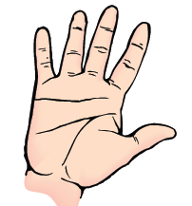
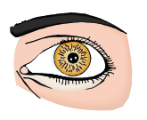
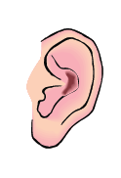
How do our perceived sensations lead to movement?
Tactile
Proprioception
Visual
Vestibular
Auditory

Slide 12
Sensing vs. Perceiving
Sensation: a physical process in which our sensory organs respond to external or internal stimuli
Perception: the brain’s process of assigning meaning to the stimuli to make sense of the world around you
  Perception can be influenced by the quality of stimuli in a given context, by past experience, by emotion, or a host of other factors.

Slide 13
Sensing vs. Perceiving
Sensing
Perceiving
Tactile: changes in pressure or temperature on the skin
Proprioceptive: detects stretch in muscles and movement in joints
Visual: detects photons in the retina
Vestibular: changes in head orientation
Auditory: changes in pressure on the eardrum
Tactile: I’m feeling something soft and it’s nice or I’m feeling something sharp and I need to move
Proprioception: I am holding onto my pen with the right amount of force to write, but need to move my arm down a little on the page
Visual: I can see my professor walking around the classroom
Vestibular: I am leaning too far to the right
Auditory: I can hear someone talking

Slide 14
”…the act of perception is a thick process. It is not just taking in a scene, but almost simultaneously, weighing its meaning, evaluating it, and generating an emotion about it.
…In fact, many scientists now believe that moral perceptions are akin to aesthetic or sensual perceptions, emanating from many of the same regions of the brain.
…Think of what happens when you put a new food into your mouth. You don’t have to decide if it’s disgusting. You just know. Or when you observe a mountain scene. You don’t have to decide if a landscape is beautiful. You just know.”
p. 285 from The Social Animal by David Brooks

Slide 15
Gorillaz – Clint Eastwood
“Y’all can see me now cuz you don’t see with your eyes, you perceive with your mind.”
“Feelings, sensations that you thought was dead. No squealing, remember, that it’s all in your head”
https://www.youtube.com/watch?v=LXiEwDnFzrk

Slide 16
Interoception vs. Exteroception
Interoception: perception of the internal environment; a sense that is stimulated from within the body
  Etymology: interior (“inside”) + ceptive (from receptive) = receive a message from the inside
  Pain (nociception), hunger, horny, thirsty, tired, internal organs
Exteroception: perception of the outside world; a sense that is stimulated by something outside of the body
  Etymology: exterior (“outside”) + ceptive (from receptive) = receive a message from the outside
  Vision, touch, hearing, smelling, tasting

Slide 17
Interoception + Exteroception
Perception of the self is always connected with the perception of the surroundings.
You are constantly perceiving properties of your environment with respect to properties of yourself
You manipulate the orientation of your body in order to manipulate your surroundings
You have to know where you are relative to where you want to be and relative to your environment in order to move

Slide 18
Recap

Slide 19
Sensing vs. Perceiving in Daily Life
Try to separate what your senses are compared to what you are perceiving
  Picking up a cup
  Brushing your teeth
  Showering
  Exercising
  Etc…

Slide 20
Sensory Perception
From now on, we will call it “Sensory Perception” because you can’t have one without the other

Slide 21
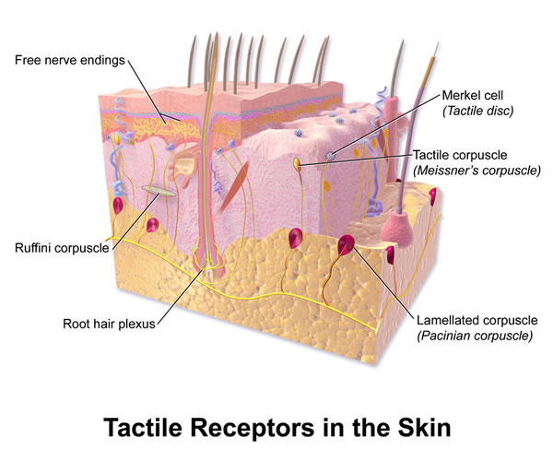
Tactile
Etymology: Latin tactilis (“that may be touched”) from tangere (“to touch”)
Receptors in skin:
  Fast or slow adapting
  Large field or small field
Free Nerve Endings: can detect temperature, mechanical stimuli (touch, pressure, stretch) or danger (nociception)

Slide 22
Proprioception
Etymology: from Latin proprius (“one’s own” or “individual”) + capio or capere (“to take or grasp”)
The sense of the relative position of one’s own parts of the body and strength of effort being used in movement.
Golgi Tendon Organs (GTO): found in tendons; detects changes in muscle tension
  Relative change in force
Muscle Spindles: Found in muscles; detects stretch and speed of stretch

Slide 23
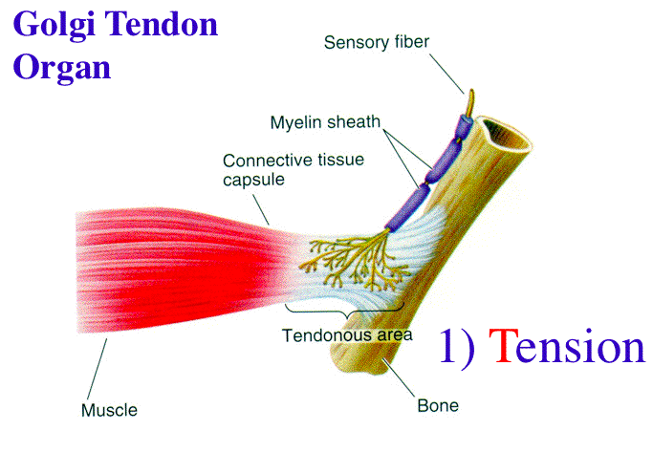
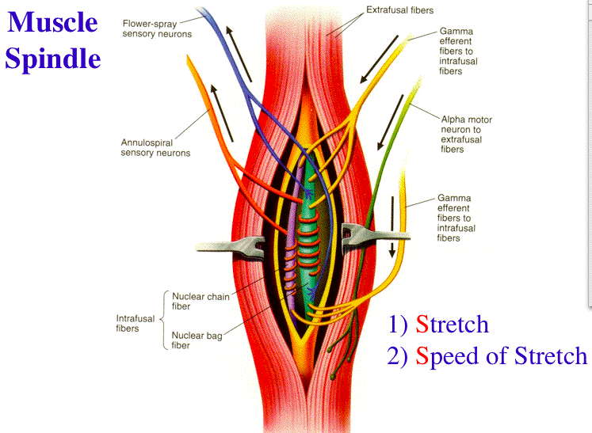
Golgi Tendon Organs & Muscle Spindles
Pictures from: https://www.unm.edu/~lkravitz/Exercise%20Phys/spindleGTO.html

Slide 24
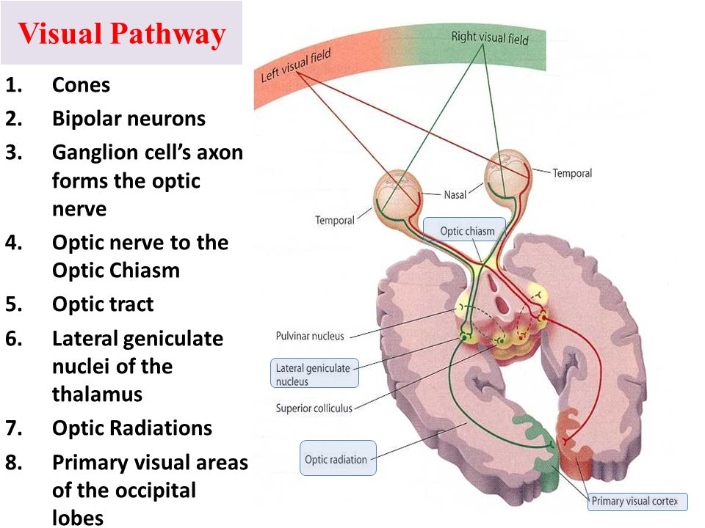
Vision
Provides information about the environment, moving objects, and your own movement
Central Vision: what we are focused on
  Highly linked to consciousness
  “What is it”
Peripheral Vision: subconscious awareness of our environment
  “Where is it”
How do we perceive 3-dimensional space?

Slide 25
Vision
Staring at my computer
Something moves in my periphery
Now I’m looking towards the thing that moved

Slide 26
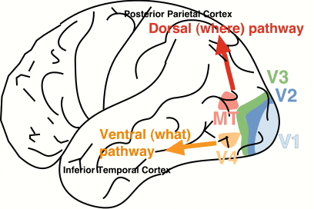
Visual Perception

Slide 27
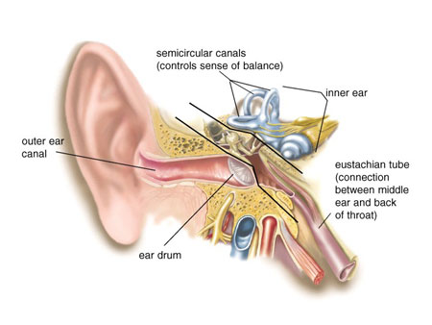
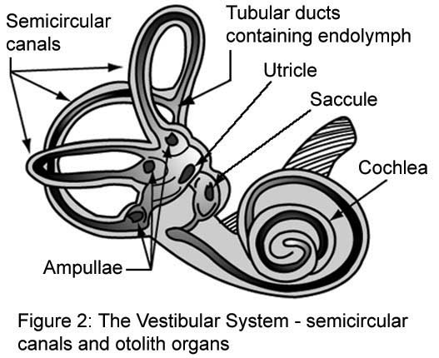
Vestibular
Etymology: vestibulum (“entrance hall”) + ar (“referring to”) = referring to the vestibule of the ear
Semi-circular canals in your inner ear
Provides information regarding the position of your head relative to the rest of your body
Sensitive to each plane of movement. (x, y, z)
Plays an important role in balance
Vestibulo-ocular reflex helps to coordinate the eyes when you move your head

Slide 28
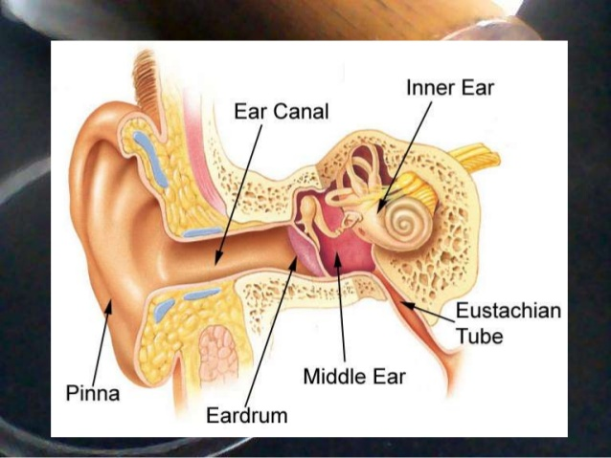
Auditory
Depending on the noise you hear, you might change the way you move
  Like if you hear a something you perceive as dangerous, you will probably run away from that noise
Rhythmic music & movement
  Like exercising to music
  Helpful for children and people with Parkinson’s disease or Autism

Slide 29
Kinesthesia or Kinesthetic Sense
Etymology: Greek kinein (“to move”) + aisthesis (“sensation”) = Movement Sense
Combination of proprioception + vestibular

Slide 30
Why do we have so many ways to sense ourselves & our environments?

Slide 31
Multi-Sensory Integration
We rarely do anything with only one sensation
  Instead, we receive information from multiple sensory modalities and use all of this information to determine what to do next
This redundancy of sensory information decreases potential for error
If one sensory modality is taken away (like closing your eyes takes away visual info), the brain relies more heavily on the other available sensory systems

Slide 32
How do we know which sense we need to pay attention to the most?
Notes:
Salience

Slide 33
How do our senses relate to movement?
Tactile:
Proprioception:
Vision:
Vestibular:
Auditory:

Slide 34
How do our senses relate to learning?
Tactile:
Proprioception:
Vision:
Vestibular:
Auditory:

Slide 35
How do our senses relate to development?
Tactile:
Proprioception:
Vision:
Vestibular:
Auditory:

Slide 36
Sensory Deficits, Differences, & Changes

Slide 37
Testing it out: How well can you write when you can’t see what you’re writing?

Slide 38
Sensing: (Fun) Practical Applications
Try to do things with your eyes closed:
  Figure out what you’re going to wear
  Shower; brush your teeth
  Get dressed
  Wash dishes (without knives)
  Text someone
  Write (or type) in a journal
  Go for a walk
Try Synesthesia:
  If the letter “A” was a color, what color would it be?
  If you were a number, what number would you be?
  If garlic was an athlete, what sport would it compete in?
  Draw music: what does your favorite song look like as a picture?

