Slide 1
Movement
Person – Task – Environment
Perception – Cognition – Action

Slide 2
Movement
Movement and motivation share the same Latin root “movere”
Why is that important?

Slide 3
Movement emerges from the interaction of three factors:
Person
Environment
Task
Movement

Slide 4
Environment
Open: Environment is constantly changing and unpredictable
  Movement is more reactive
Closed: Environment is stationary and predictable
  Movement can be planned in advance

Slide 5
Task
Discrete: a distinct beginning and end
Serial: a series of discrete tasks strung together
Continuous: no distinct beginning and end; the task continues until the person decides to stop

Slide 6
Task
Stability: the purpose of the task is to remain still (non-moving base of support)
Mobility: the purpose of the task is to move your base of support
Manipulation: the purpose of the task is to move something else

Slide 7
Person
Perception: Perceiving the relevant environmental features
  “Sense”
Cognition: Decided what to do and where and when to do it to achieve the goal
  “Think”
Action: Producing organized muscle activity to generate movements that achieve the goal
  “Do”

Slide 8
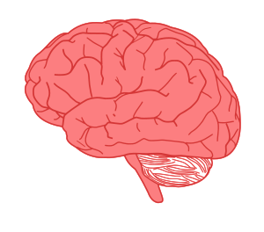


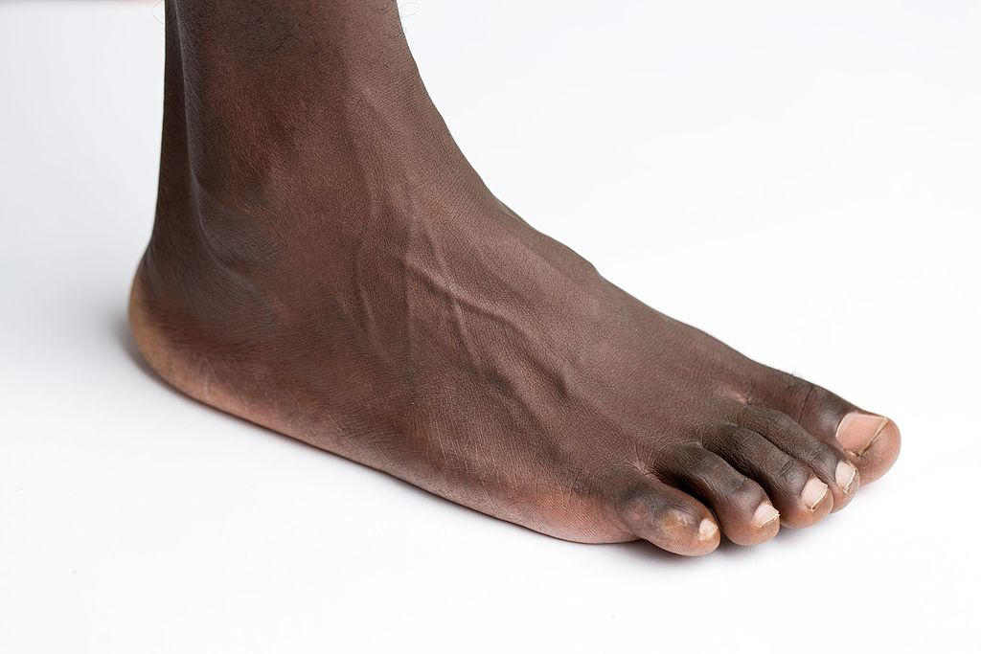
Cognitive Processing
Motor Action
Sensory Perception
Feed-Back
Feed-Forward
Notes:
Another way to look at the information processing model is as a continuous cycle. Or as a conversation between the brain and the body.
Feedforward or a top-down approach
Feedback or a bottom-up approach
Our ability to produce coordinated movement in a variable environment reflects the essential relationship between the feedforward motor plan and sensory feedback.

Slide 9
Team Work in Classifying
Person Task Environment

Slide 10
How are movement and motivation related?
Class Discussion

