Slide 1
Teaching Games for Understanding (TGfU) As a Curriculum Model
Butler & McCahan (2005)

Slide 2
Purpose
Examine how the inherent assumptions and values of TGfU can help teachers develop a games curriculum
Compare the TGfU model with the technique model
Examine the TGfU classification system
Show how to create a spiral curriculum
Provide planning considerations using a sample TGfU games program
Describe the learning steps involved in the TGfU model
Offer guidelines for implementation

Slide 3
Inherent Assumptions and Values
Effective curriculum Models :
  Potential to:
    Align educational priorities (what is taught)
    Educational philosophy (why things are taught)
    Educational methods (how things are taught)
Curriculum Model Adopted:
  What is the role of the learner?
  What is the role of the teacher?
  What is the social and structural context of the learning environment?
  How will learning be assessed and evaluated?

Slide 4
Inherent Assumptions and Values
TGfU Model
  Based
    On constructivism
  Advocates
    Comprehension and meaning be built gradually using experiences and contexts that help students become willing and able to learn
  Uses
    Problem solving, tasks, groups, and sharing activities to provide learning that can be structures around basic concepts
Notes:
A challenge for PE teachers is to break away from the esxclusive use of direct instruction (developed in the 1940s
Most physical educators came through their early school years with a technique approach and went on to use it to help students master techniques
Table 3.1

Slide 5
Inherent Assumption and Values
Technical Model (Direct Instruction)
  Ralph Tyler 1949
  Emphases
    On performance
    Allows little room for creativity or learner empowerment
  Step – by – step process of curriculum development
    Provide blueprint for teaching
  Uses
    Objectives in planning programs and instructional episodes
    Selection of subject matter and teaching strategies based on intended learning outcomes expressed as behavioral objectives
    Assessment of the behavioral outcomes of instruction involving measurement and quantification
Notes:
Table 3.1

Slide 6
Curriculum (What Is Taught): Comparing the Technical Model With the TGfU Model
Areas of Consideration
  Why it is taught
    Based on assumptions about society, humanity, and education
  What is taught
    Represents the operational mode of theories
  How it is taught
Purpose: Acquisition of Knowledge vs. Construction of Meaning
  Curriculum
    Derived from a set of values and beliefs
  Underlying Question:
    Why do we teach Games?
Technical Model vs. TGFU Model
  Technical:
    Focus in on psychomotor learning with cognitive learning as a second priority
  TGfU:
    Encourages students to construct meaning from the situations (apply games skills)
Notes:
Curriculum theories based on philosophical and historical perspectives
The curriculum model based on the why and conceptual framework
Pedagogical perspectives including action and reflection
If the purpose is to train students to replicate behaviors or skills: use technical approach… Content is broken down into small steps, modeled, then students practice.
If the purpose is developing deeper understanding, syntheis, decision making, and the ability to use information in a variety of situations
People using the TGfU approach are less likely to ask questions: why are we doing this? When can we play a game?

Slide 7
Objective: Defining What We Know vs. Discovering What We Don’t Know and Applying What We Know
Technical Model:
  Teacher’s Objective
    Teach the student the information effectively and efficiently Transmission
    Assumptions that all students start with the same knowledge, learn at the same rate, and will learn using this style
TGfU Model:
  Teacher’s Objective:
    Offer all students, regardless of ability or skill level, the opportunity to actively experience, enjoy, and understand games.
    “Curriculum work as craft”
    Student assumptions are challenged and their decisions are negotiated
Notes:
Students behaviors are much less predictable when the TGfU approach is used
….Students are encouraged to listen, explore, discuss, and create ideas.

Slide 8
Outcome: Performance vs. Thinking and Decision Making
Technical Model:
  Students will become skillful performers
  Expected to be orderly, compliant, and respectful
TGfU Model:
  Shift focus from how to why or what if
  Encourages students to reflect and to ask questions
    Develop:
      Skills in negotiating, compromising, and listening through group-work
  Required:
    Make creative decisions, to question, and to challenge themselves and others

Slide 9
Game Frameworks: Seasonal Activities vs. Classifications
Technical Model:
  Organizes curriculum in imitation of the seasonal cycles of professional sport
TGfU Model:
  Classification system for its framework and bases the inclusion of games on a systematic selection process
Notes:
Games with simialr intent are linked together. Table 3.2

Slide 10
TGfU Classification of Games
Games Classification:
  Invasion
  Net/wall
  Striking/fielding
  Target sports
Territorial and team passing sports
Game Components:
  Intent, concepts and skills, players’ roles, playing area, and offensive and defensive strategies
  Progression
Notes:
Highlighting relationships increases tactical complexity and greater decision making
The concept and skills embedded in target and striking games form the foundation for the more conceptually sophisticated and complex net and territorial games
Conceptual framework

Slide 11
Sample TGfU Games Program
Games Education Program
  Attempt to offer a TGfU program for grades 3 – 12
Consider
  Time
    Required to develop a game
  Focus
    Few games at each grade level
  Sampling
    Need to experience a number of games to understand similarities and differences
  Readiness of learners
    Games based on development level of students
  Intertask transfer
    Maximize transfer of learning that occurs from one game to another within the classification
  Intratask tansfer
    Curriculum arranged so that skills and concepts learned in each game transfer to the next level of difficulty
  Spiral curriculum
    Categories should be revisited ever year. Spirals to more advanced levels of instruction and material
  Standards
    NASPE
Notes:
Table 3.4
Many classes usually disproportionate 60-90% of the PE programs to games education

Slide 12
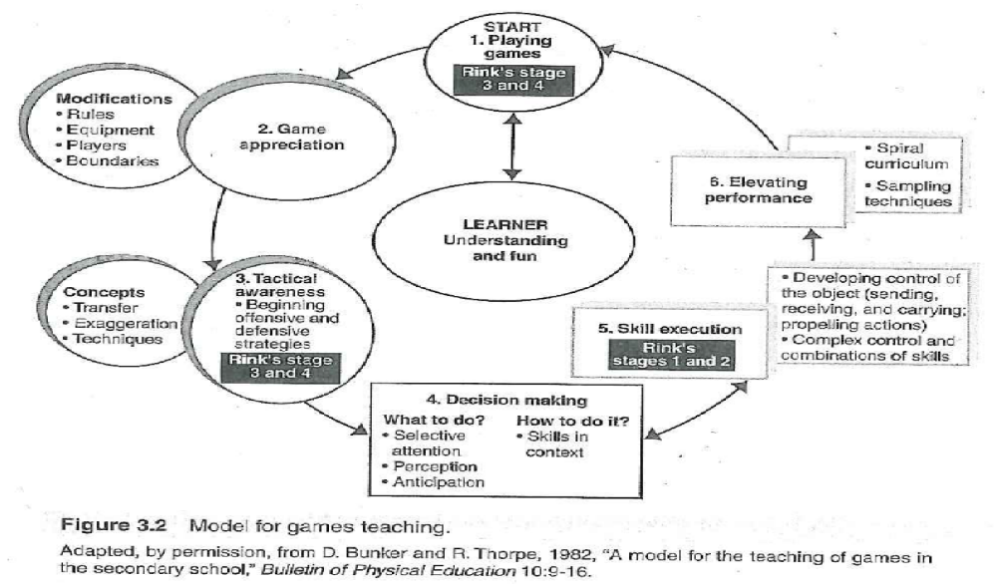
TGFU Model

Slide 13
TGfU Model Steps
Game
  Every child to participate
  Modify rules, equipment, play area, and group size
Game appreciation
  Understand and respect rules because students create, implement, and refine them
Tactical awareness
  Understand and know the game through solving problems
Decision making
  Paying attention to relevant actions, anticipating responses by opponents, and choosing appropriate skills
Skill Execution
  Learned in context and practices after the game is played
Performance
  Increases as cycle continues

Slide 14
Implementing the TGfU Model
Guidelines
  Clarify your own education philosophy
  Compare the ideas that make up your philosophy
  Decide what learning outcomes are being sought and what tye of learning environment
  Start with one cooperative class
  Start with an activity with strong content
  Combine efforts with other physical educators
  Seek administrative support for implementation
  Involve school district curriculum planners

Slide 15
Conclusion
TGfU
  Emphasis on the values of learner centered teaching and outcome based planning
  Promotes the holistic and transformational education of children
Process of changes
  Helps educators step into learners shoes and teach in accordance with values
Those who espoused more progressive beliefs taught more progressively

