Slide 1
TGFU Net/Wall Games

Slide 2
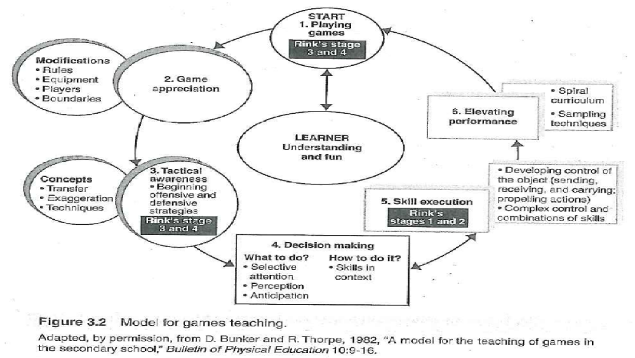
TGFU Model

Slide 3
Net/Wall Games Overview
Similarities
  Consists of 2 Opposing Teams OR individuals
  Divided by net OR shared playing field/court
  Objective
    Transfer object into an opponents court within boundaries so that they are unable to return.
Differences
  Court sizes/shapes
  Ball allowed to bound or not prior to return
    Focus
      Acquiring skills
      Execute tactics

Slide 4
Net/Wall Games Overview
Net/Wall Games
  2 categories
    Racquet/Paddle-Badminton, Pickleball, Tennis, Table Tennis
    No Racquet-Paddle-Volleyball, Walley-ball, Handball, Racquetball
Transferable Concepts
  Spatial Awareness
  Court Positioning
  Locomotor Skills
  Agility (Change Directions)
  Attack-Shot Trajectory
  Attack-Shot Depth/Angles

Slide 5
Net/Wall Games-Concepts & Skills
Concepts | Skills
Spatial Awareness | Throwing, Catching on Bounce & Volley, & Serving and Receiving Serve
Positioning on Court | Running, Stopping, & Changing Directions
Positioning of Body | Balance, Footwork, & Hitting the Ball in Relation to Body
Shot Trajectory | Throwing & Catching
Shot Depth | Hitting w/specific Force, Lob Shot, Drop Shot, Spin Shots, Volley, Drives, & Dig
Angles | Control of Racquet, Angle of Racquet, Volley, Forehand, & Backhand

Slide 6
Tactical Awareness
Initial Tactical Awareness Components
  SPACE
    Where an object should be placed in the area of play, and
    Where a player should go in the area of play based on the placement of the object.
  TIME
    When to execute a skill within a game,
    When to create time to play a shot, and
    When to reduce opponent’s time.
  FORCE
    How much force to apply on an object for speed, distance and height.
    How to apply force on an object for height, directional control and distance.

Slide 7
Principles of Play
Consistency
Placement
Positioning
Spin/Power
Tactical Awareness Components
  Space
  Force
  Time

Slide 8
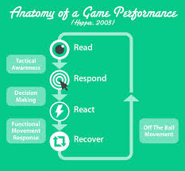
Decision Making
￼
Notes:
Players have to read the situation and decide where they should locate themselves on the court
Respond with appropriate movement skills (Cover, Off-ball movement skill selection and then skill execution)
As the ball eneters the court, the player reacts to the force, spin and direction of the ball (Adjust, on the ball skill selection, then skill execution)

Slide 9
Four R’s
READ: Player reads cues in the game situation, makes decisions, and re-locates within the play area.
RESPOND: Player makes appropriate cover movements in the area of play, selecting the appropriate skill for the situation.
REACT: As object enters player’s play area, the player makes an adjustment to the object’s force, spin and direction, and executes appropriate “on-the-ball” skill.
RECOVER: After skill execution, player makes appropriate recovery movements to set-up for the next READ phase.

Slide 10
Assessing Skills
Base
  Player makes an appropriate return to a home or recovery position between skill attempts.
Decision Making
  Player makes appropriate choices about where to place the object or when defending space.
Cover
  Player makes defensive movement in relation to object being played by an opponent (cover space) or provides defensive help to a teammate making a play on the ball
Adjust
  Player moves appropriately, (offensively or defen- sively), as required by the play of the object in the game.

Slide 11
Assessing Skills
Skill Execution
  Player executes efficient performance of selected skills.
Support
  (pass used): Player makes off-the-ball movement to a position to receive a pass when the player’s team has possession.
Guard or Mark
  Player defends against an opponent who may or may not have the ball.

Slide 12
Player Roles & Playing Area
Player Roles
  Requires same skills and players rotate positions
Playing Area
  Area Divided by Net
  Opposing Players are Separated

Slide 13
Offensive Strategies
Ball Placement away from Opponent
Ball Placement close to Boundary Lines
Moving to Volley Position at Net
Intercepting/Anticipating
Employing Strikers

Slide 14
Defensive Strategies
Returning Object and keeping in Bounds
Anticipating where opponents will return object.

Slide 15
Volleyball Content Analysis Example
Tactical Problem | Skill (on ball) | Movement (off ball) | Progression
Recognizing/Using Space on Court | Appropriate Shot Selection | Preparation and Movement to space for offensive shots | STEP Games Appreciation
Anticipating for defensive positioning | Racquet position and defensive stance | Appropriate body and racquet positioning to defend against a variety of shots | STEP Games Appreciation
The amount of force used on a shot | Flicking the wrist, good contact with the racquet, force generation, accurate follow through | Good preparation, proper footwork, body position relative to the birdie | STEP Games Appreciation
Offensive strategies | Offensive shot selection: smash, net shots, drop shots, overhead clear. Ability to deceive your opponent or fake a shot. Hitting the bird where your opponent is not. | Position on court relative to opponent's position on the court. Fast and efficient movement on the court (not getting stuck in defensive situations). | STEP Games Appreciation
Serving | Selection of serve to take advantage of opponent's position and weaknesses. Good execution of discrete serving skills. Proper placement of serve. | (Receiving the serve) Reading the stance of the server to anticipate what serve is coming. Low, ready stance, defensive racquet position. | STEP Games Appreciation

