Slide 1
Pickle-Ball
Rules & Terminology

Slide 2

Overview/Historical Facts
Combination of skills from tennis, badminton, and table tennis
Invented in 1965 in Bainbridge Island, WA by a US Congressman (Joel Pritchard) and his friends
Developed as a family game that could be played in a backyard or driveway
Named after Pickle, Pritchard’s Cocker Spaniel named pickle

Slide 3
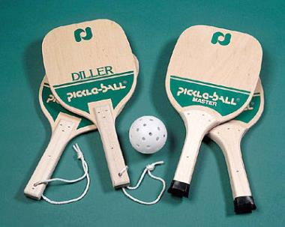
Equipment Used
Pickle-ball paddles are made of wood or high-tech aerospace materials (plastic)
Traditional pickle-ball ball is slightly smaller than traditional wiffle ball used for baseball.

Slide 4
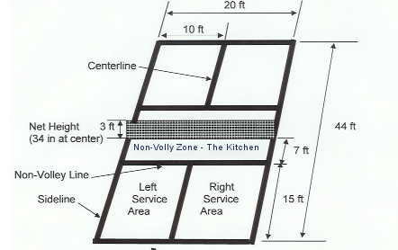
Court Dimensions

Slide 5
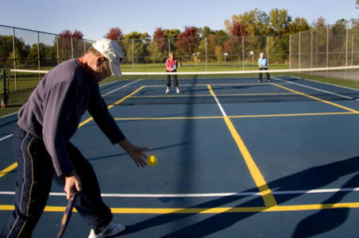
Serving
Must Keep one foot behind
back line
Must be underhand (paddle
passed below waist)
Must hit ball out of air (not on bounce)
Only one serve fault is allowed, unless ball hits net and falls into appropriate service box on opponent’s side
Must land in diagonal service court
Team starting the game is allowed only one fault: rest of game each team member serves prior to change of possession

Slide 6
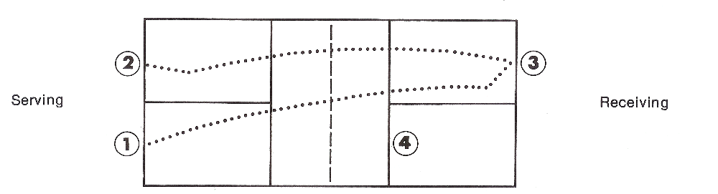
Position of Players at the Serve
Double-Bounce Rule
  Each team must play the first shot off of the bounce.
  Receiving team must let the serve bounce
  Serving team must let the return of the the serve bounce before playing it
  Once these two bounces have occurred, the ball can either be volleyed or played off a bounce

Slide 7
Bounce Rule
Each team must play the first shot off of the bounce
  On the serve, receiving team must let ball bounce once prior to returning ball over net
  Serving team must do the same
  Once these two bounces have occurred, the ball can either be volleyed or played off a bounce

Slide 8
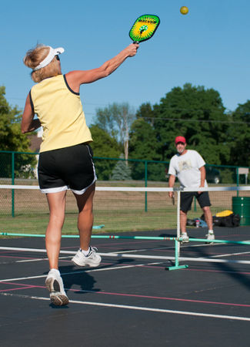
Volleying
VOLLEY = hitting the ball out of the air without a bounce
Only allowed BEHIND non-volley zone
Cannot follow-through with foot into non-volley-zone

Slide 9
Faults Occur When:
Ball is hit out of bounds
Ball fails to clear net
Player volleys ball before it has bounced once on each side of court following a serve
Player violates non-volley rules
Ball bounces more than once before being returned
Scoring
A point is scored only for the serving team
Game is played to 11; team must win by 2

Slide 10
Other Important Points
A ball touching any line is playable
Serving team always starts first serve on right side of court, and serves diagonally across net
When serving team wins a point, the same player serves again after switching sides of own court with teammate
When serving team makes its first fault, it stays on same side of own court and second person serves (expect for the first possession of the game)

Slide 11
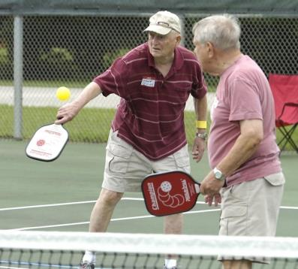
Pickle-Ball Etiquette
Calling opponents’ shots
Calling own shots
“Do-Overs” Allowed
Fun & Spirit of the Game

