Slide 1
Frameworks for Diagnosing Student Performance Problems in Striking/Fielding and Target Games
Fisette & Mitchell, 2010

Slide 2
Teaching Games For Understanding
Teaching games for understanding
  Uses a constructivist approach to learning
  It builds on students' prior knowledge of and experiences with sport-related games within a socially constructed environment
Instead of providing information
  Teachers present game situations (tactical problems) that challenge students with game tactics and involve them in the decision-making process
    (Bunker & Thorpe, 1982; Griffin, Butler, Lombardo, & Nastasi, 2003; Launder, 2001; Mitchell, Oslin, & Griffin, 2003,2006; Turner, 2005)
Students become responsible for their own learning
  While teachers facilitate students' learning process and opportunities

Slide 3
Introduction
Advocates of TGFU argue
  As students start to take ownership of their learning, they begin to feel a sense of empowerment
    Which increases their level of engagement in sport-related games
      (Griffin et al.; Mitchell et al., 2003, 2006; Turner)
A common goal for most physical education teachers
  Provide students with opportunities that will enhance their enjoyment of sport-related games
    In the hope that they will continue being physically active throughout their lifetime
This can be facilitated by exposing students
  Games in which they learn to solve problems and make decisions
    In order to extend their game understanding beyond the school gymnasium and fields
By beginning instruction with a game
  Students are allowed to think tactically, make decisions, and solve problems with their peers within the social dynamics of game play
  Students learn skills and movements within a game context
    Which leads to improved game understanding and performance

Slide 4
Introduction
The teachers role is critical
  The improvement of students‘ tactical awareness and game understanding might not occur
    Without the teacher's ability to observe game play and diagnose performance problems
      (Mitchell & Collier, 2009)
Knowing what questions to ask
  Diagnosing performance problems based on students' game play
  Fostering opportunities for students to think critically and solve the tactical problem
Notes:
For this to occur the teachers role is critical
Teachers may be able to follow the TGFU game-practice game format, but

Slide 5
Nature of Striking/Fielding and Target Games
Each classification has its own goals, primary rules, and problems to be solved
  Both offensively and defensively
  There are additional differences among the game categories.
    Invasion and net/wall games tend to be the most commonly taught in physical education curricula
      (Mitchell & Collier, 2009)
    Striking/fielding and target games are taught less frequently
Striking/fielding and target games
  Have less "flow" and a slower pace compared to invasion and net/wall games
    Which decreases the level of tactical complexity in them
The slower paced nature of games such as softball and golf provides
  Students with more time to make fewer decisions within game play and gives teachers more opportunity to observe student performance
Notes:
The games classification system is the TGFU framework
that organizes games based on their primary rules, which
identify how the game is played and how winning can be
achieved (Almond, 1986).

Slide 6
Nature of Striking/Fielding and Target Games
In softball
  The tactical decisions that students need to make are situation specific
    On offense, a right-handed batter will need to determine where to hit the ball with runners on first and second with one out
    Defensive players should understand where to throw the ball, move to, or cover, depending on where the ball is hit
In target games
  There is a greater emphasis on the set-up and pre-shot routines-decisions that are made before skill execution even takes place

Slide 7
Nature of Striking/Fielding and Target Games
Students are unopposed
  Golf or bowling
Student are opposed
  Croquet or bocce
Playing golf
  Students will first need to select a club based on the distance to the target and potential barriers
  Accounting for factors such as the "lie" and the wind
During a game shuffleboard
  Students must determine whether they will try to score or attempt to block their opponent from scoring
Teachers have additional time
  To observe and diagnose performance problems that occur before and during game play

Slide 8
Diagnosing and Addressing Game-Performance Problems
First thing teachers need to determine
  The students have a problem scoring or preventing their opponent from scoring
Target games
  Teacher can again use the framework to diagnose why students are having problems scoring or preventing their opponent from scoring
The problem diagnosis will focus only on scoring
  Because most target games taught in physical education are unopposed
    Golf and bowling
Tactical decisions
  Are made before the skill is executed
    Unlike in invasion and net/wall games, in which decisions are more spontaneous and occur during game play
      (Mitchell et al, 2003)
Notes:
when observing game play is whether

Slide 9
Diagnosing and Addressing Game-Performance Problems
Novice golfers
  Might have difficulty selecting a club based on the distance to the target
    They may be unfamiliar with the available choices and the stances that align with each club selection
      Example, a student may select a 3-iron instead of a 9-iron or pitching wedge to chip the ball onto the green.
        Since they are unfamiliar with their club selection, they set-up for a full swing instead of a chip shot
Bowling
  Students might be able to knock down pins with their first ball, but they may have difficulty picking up a 5-10 split

Slide 10
Diagnosing and Addressing Game-Performance Problems
Teachers might observe
  That the students are inconsistent in their set-up and approach
    Which demonstrates their lack of understanding of how to approach the first and second bowls in a frame
The problem
  Students are having difficulty determining how to approach a shot
Teacher questioning should guide students to think critically about what they are doing before the shot or bowl that ultimately determines the end product
  Getting the ball on the green or picking up the spare

Slide 11
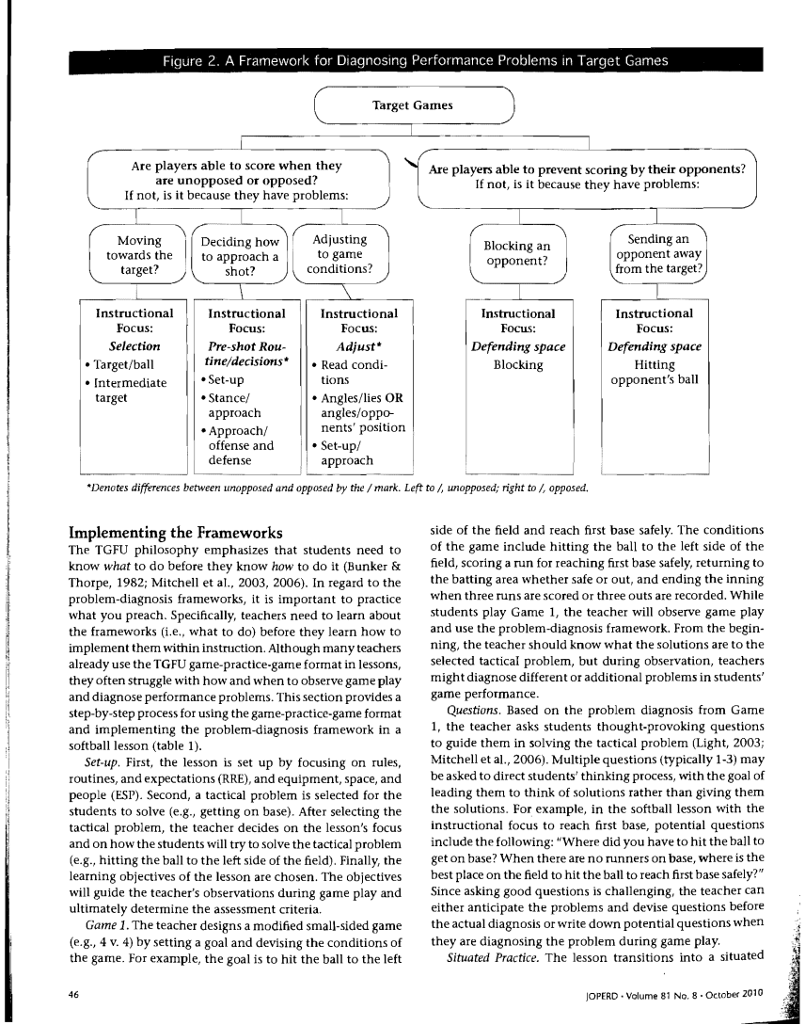
Framework For Diagnosing Performance Problems In Target Games

Slide 12
Implementing The Framework
The TGFU philosophy
  Emphasizes that students need to know what to do before they know how to do it
    (Bunker & Thorpe, 1982; Mitchell et al., 2003, 2006)
Implementing
  Set Up
  Game 1
  Questions
  Situated Practice
  Game 2

Slide 13
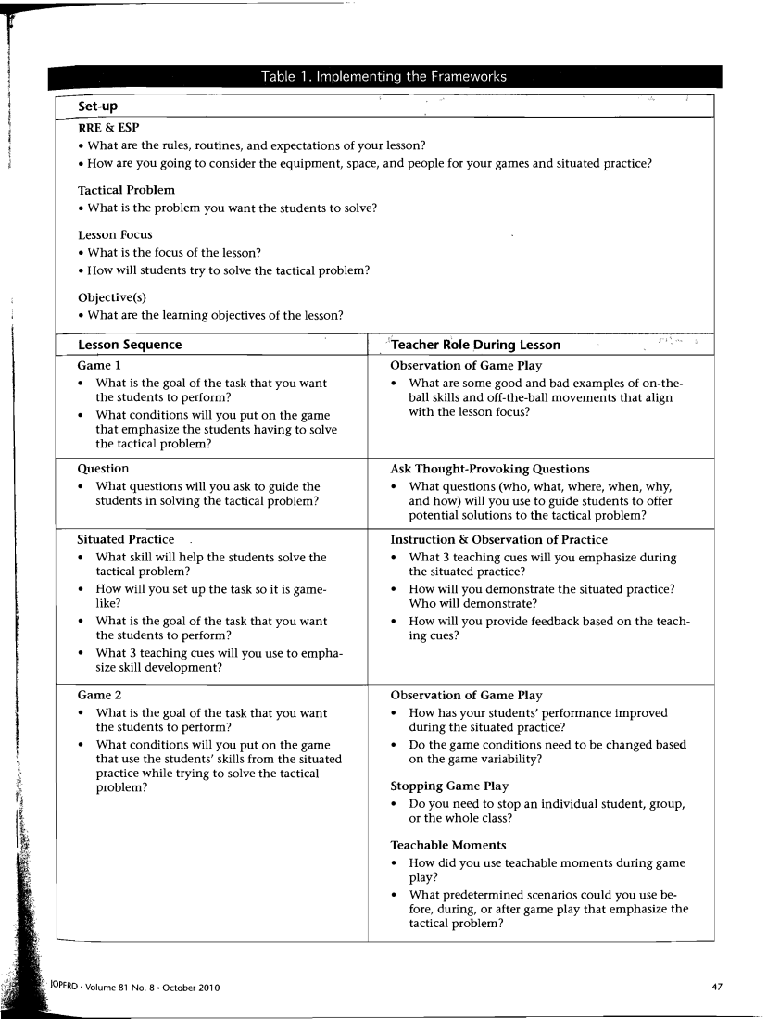
Games-Practice-Games Format

Slide 14
Conclusion
Problem-Diagnosis Framework
  Designed to simplify the challenges that teachers face in pinpointing student performance problems during game play
The framework guides teachers
  To formulate thought-provoking questions to enable students to determine the problems and potential solutions for themselves
The problem-diagnosis frameworks
  Can be used to prepare questions for student s, determine instructional foci, identify teachable moments or relevant points for feedback, and for formative and potentially summative assessment purposes
As teachers
  Become more proficient in diagnosing problems and creating questions that foster critical thinking, they can have students observe and assess their peers
    Which can increase students' game understanding and overall game performance
The problem-diagnosis frameworks provide
  Observational tools that have the potential to guide their instructional foci as they attempt to increase students game understanding and performance

